Slide 1

BRITISH AIRWAYS
Predicting Customer Buying Behaviour

Slide 2
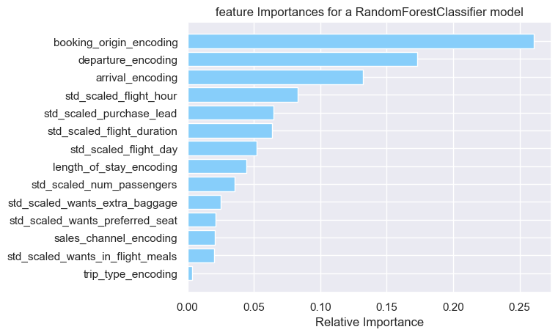
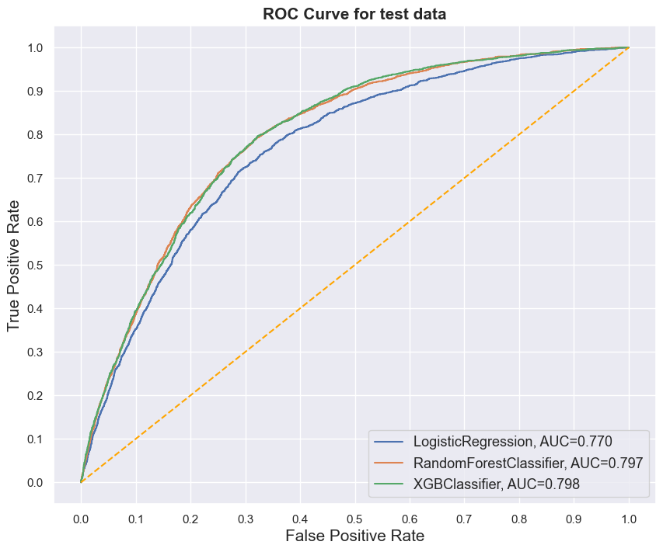
Predictive Model to Understand Factors That Influence Buying Behaviour

